Slide 1
UI Components in Magento 2
KO - Building AdminUi easier :)

Slide 2
Overview
Ui component structure
Technologies
Knockout + Magento component
How it’s work

Slide 3
Introduction

Slide 4
What is a UI Component?
In a nutshell a UI Component is an easily reusable collection of PHP, Javascript and HTML code that provides one user interface functionality. A UI component can easily be used anywhere within your layout files using only this small snippet.
<uiСomponent name="some_ui_component_instance_name"/>
This will make more sense later, but it also looks like UI Components add the M (model) to KnockoutJS’s MVVM (or really VVM) architecture. This architecture is used to build all of Magento 2’s front end.

Slide 5
Structure
UI Components are made up of ‘Basic Components’ and ‘Secondary components’. The Basic Components are:
Listing Component - Visualising and filtering data
Form Component - CRUD
The Secondary Components can be used to extend the functionality of the Basic Components. Each Basic Component has it’s own set of Secondary Components. The latest devdocs (2.1) have a partial list of all components here. You can also find all the available UI Components listed in this definition.xml (more on that later).

Slide 6
Technologies
KnockoutJS
From the KnockoutJS site:
Knockout is a JavaScript library that helps you to create rich, responsive display and editor user interfaces with a clean underlying data model.
What is KnockoutJS?
KnockoutJS uses an MVVM (model–view–view-Model) architecture to create interfaces that update when an underlying data model is changed.
Knockout’s MVVM looks like this:

Slide 7
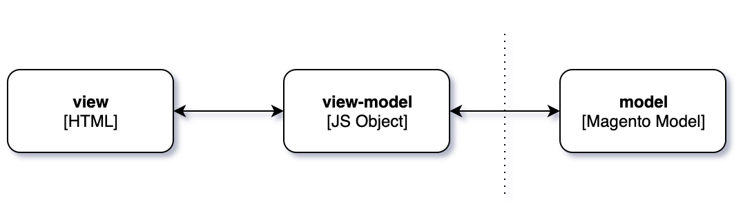
How does it work?

Slide 8
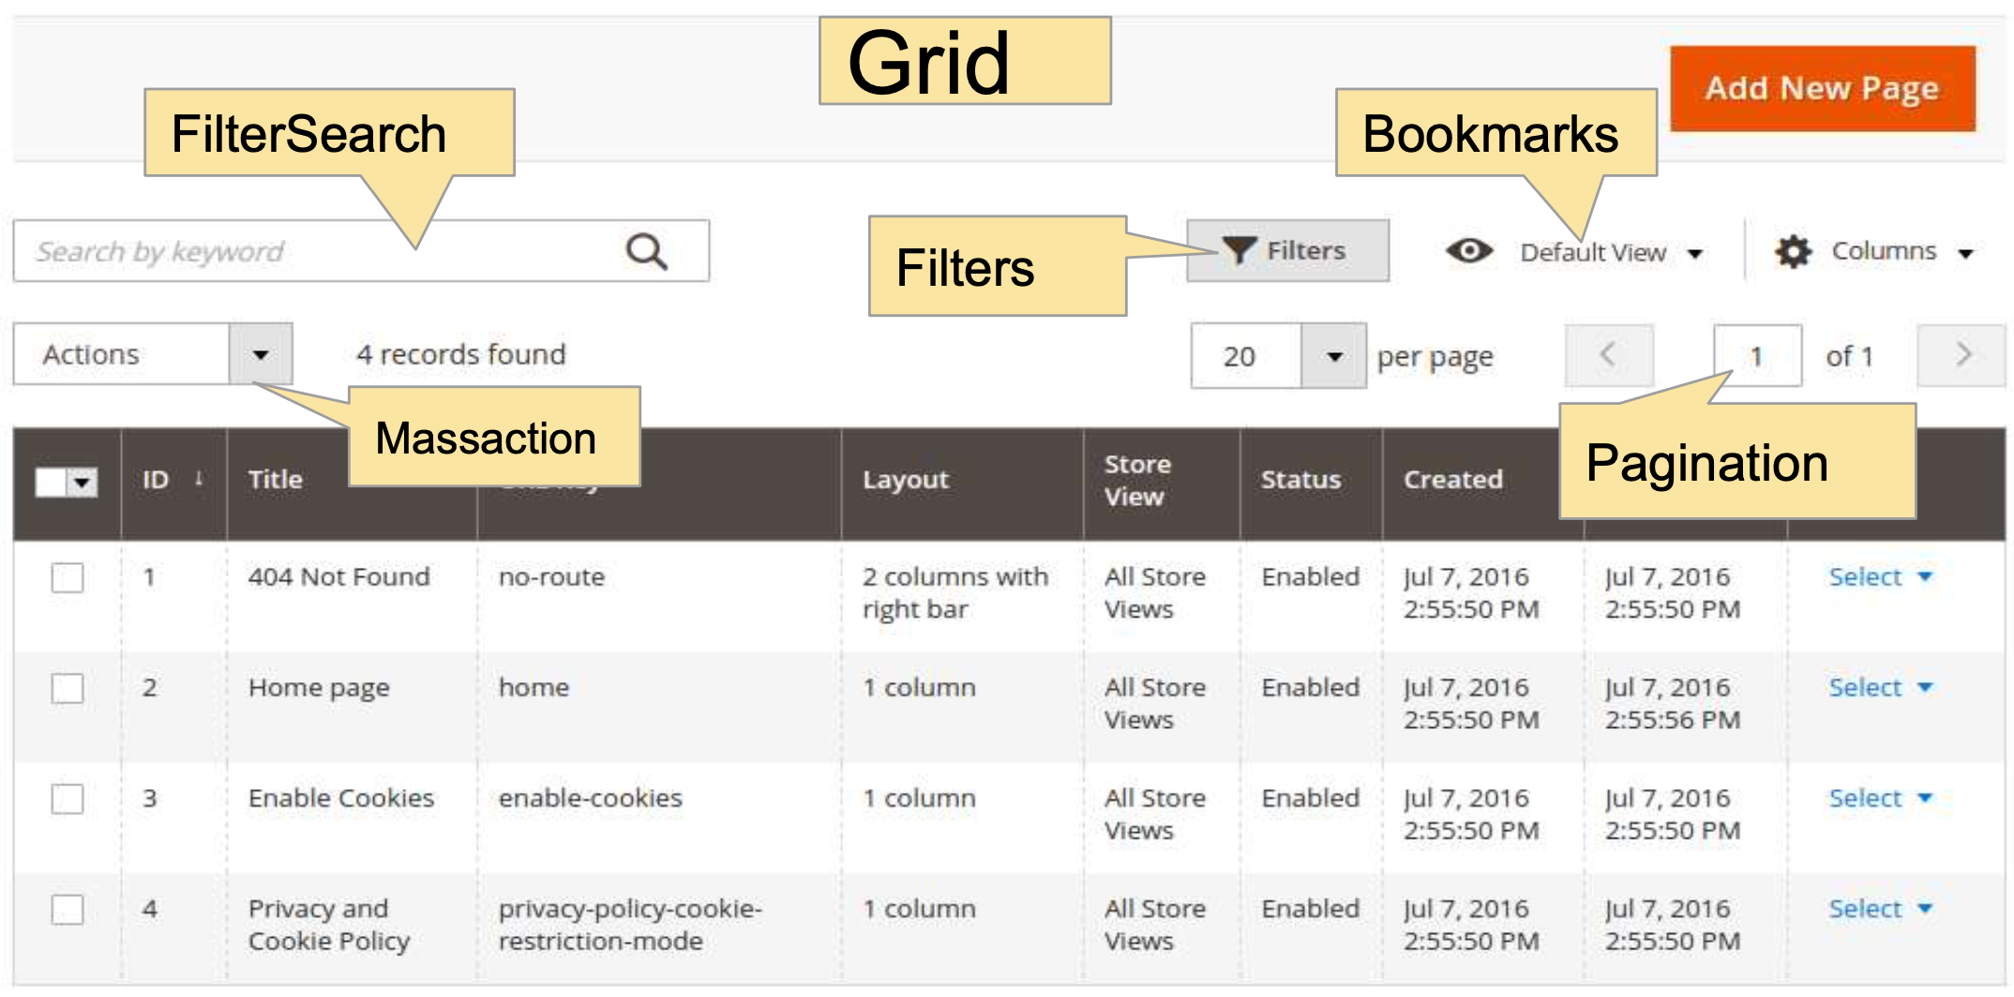

Slide 9
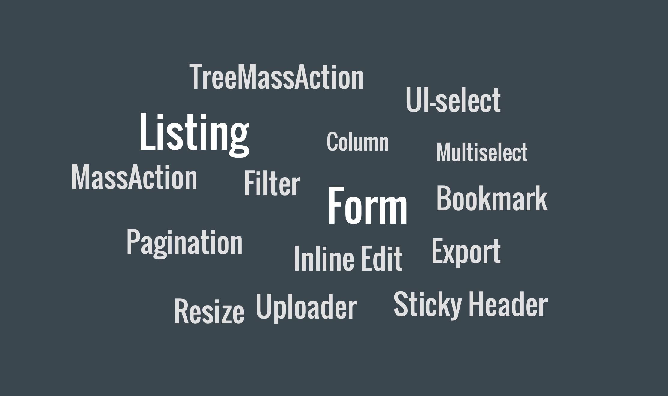

Slide 10
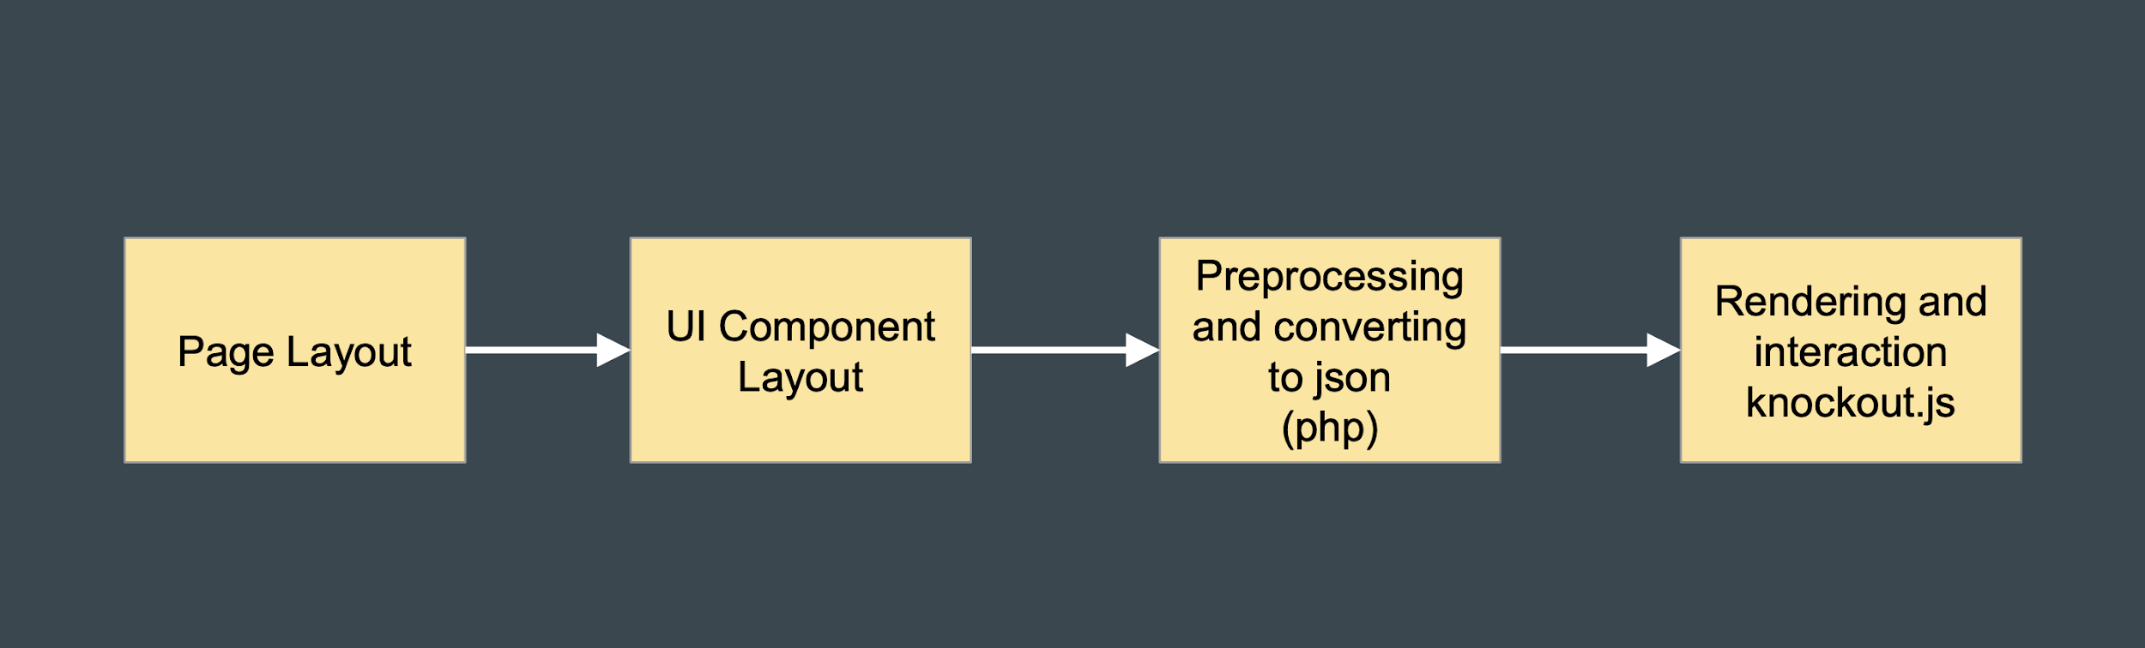
Render process

Slide 11
Let’s start :)

Slide 12
Thank you! :)
Docs:
https://edmondscommerce.github.io/introducing-ui-components/
https://alanstorm.com/knockoutjs_primer_for_magento_developers/
https://alanstorm.com/magento_2_knockoutjs_integration/
DemoRepo:
https://github.com/ufoxix/workshop

